Slide 1


IEEE Student Branch website of Geethanjali College Of Enginnering and Technology

Slide 2
Under the Guidance of : Dr . Neha Nandal Done By : Shivanoor Vignesh(21R11A0597) Gurram Anish Goud(21R11A0571) Dirisam Preethi (21R11A0566)

Slide 3
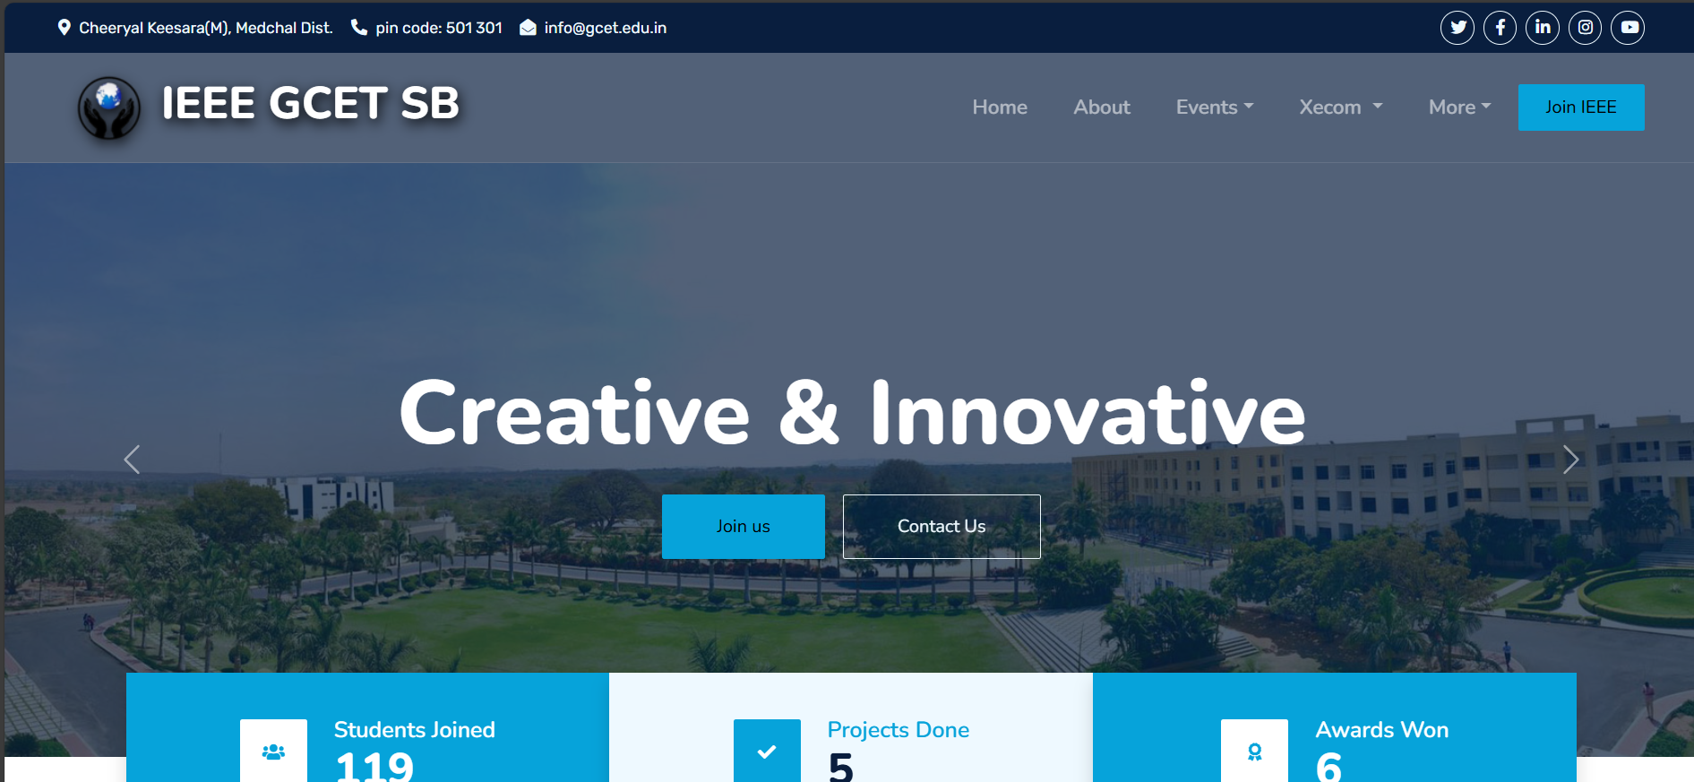
CONTENTS
Abstract
Existing System and Proposed System
System Configuration
System Architecture
Modules
UML diagrams
Implementation
Project Execution
Future Scope
Conclusion

Slide 4
ABSTRACT
The IEEE student branch at Geetanjali College of Engineering and Technology aims to enhance its online presence and engagement with students through the development of a comprehensive website.
This project focuses on creating an informative and interactive platform that serves as a central hub for the student branch community.
The website will showcase student projects, provide updates on events and workshops, offer online membership registration, and integrate social media platforms for easy sharing of content.
The goal is to improve communication, increase participation, and foster a sense of pride within the IEEE student branch community.

Slide 5
Existing System
Manual Promotion: All event promotions, including posters, banners, and announcements, are done manually using papers and physical materials.
WhatsApp Group: Communication and coordination for events are primarily conducted through a WhatsApp group, where updates and information are shared.
Lack of Online Presence: The current system lacks a website or online platform for promoting events and showcasing achievements, limiting visibility and engagement.
Limited Reach: Reliance on manual methods and a single communication channel (WhatsApp group) may limit the reach and effectiveness of event promotions and information dissemination.

Slide 6
Proposed System
User-Friendly Interface: Develop a welcoming homepage with an intuitive navigation menu for easy access to different sections of the website.
Project Showcase: Include a section to highlight student projects with detailed descriptions and multimedia elements.
Events Promotion: Provide a dedicated section to inform visitors about upcoming events, workshops, seminars, and hackathons, including event details and registration information.
Membership Section: Create an exclusive section outlining the advantages of IEEE student branch membership, with an online registration process.
Contact Information and Feedback Form: Include contact details for student branch leadership and a feedback form for visitor suggestions and inquiries.
Social Media Integration: Integrate links to the IEEE student branch's social media profiles for easy sharing of website content

Slide 7
System Configuration
Software Requirements
Operating System: Windows 11
Framework: React js
Server-side Scripting Language: Python Using Flask
Database management system : MongoDB
Editor: Visual Studio Code
Hardware Requirements
Laptop

Slide 8
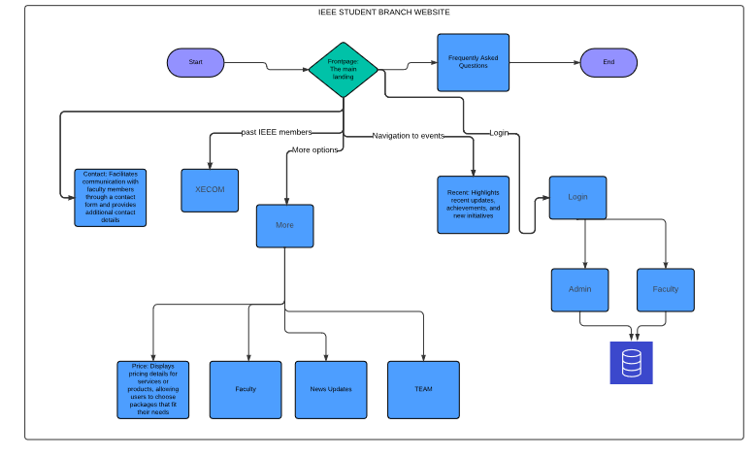
SYSTEM ARCHITECTURE

Slide 9
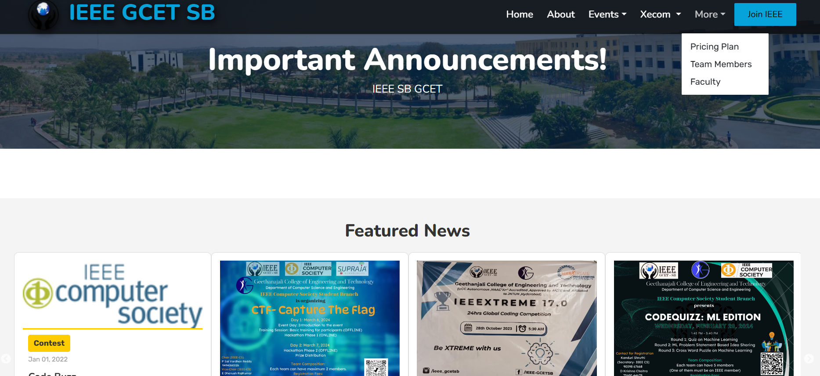
MODULES
Home page/Front page
Events
Contact us
Recent Events
About
Pricing Plans
News Updates/Announcements
Team us
Login

Slide 10
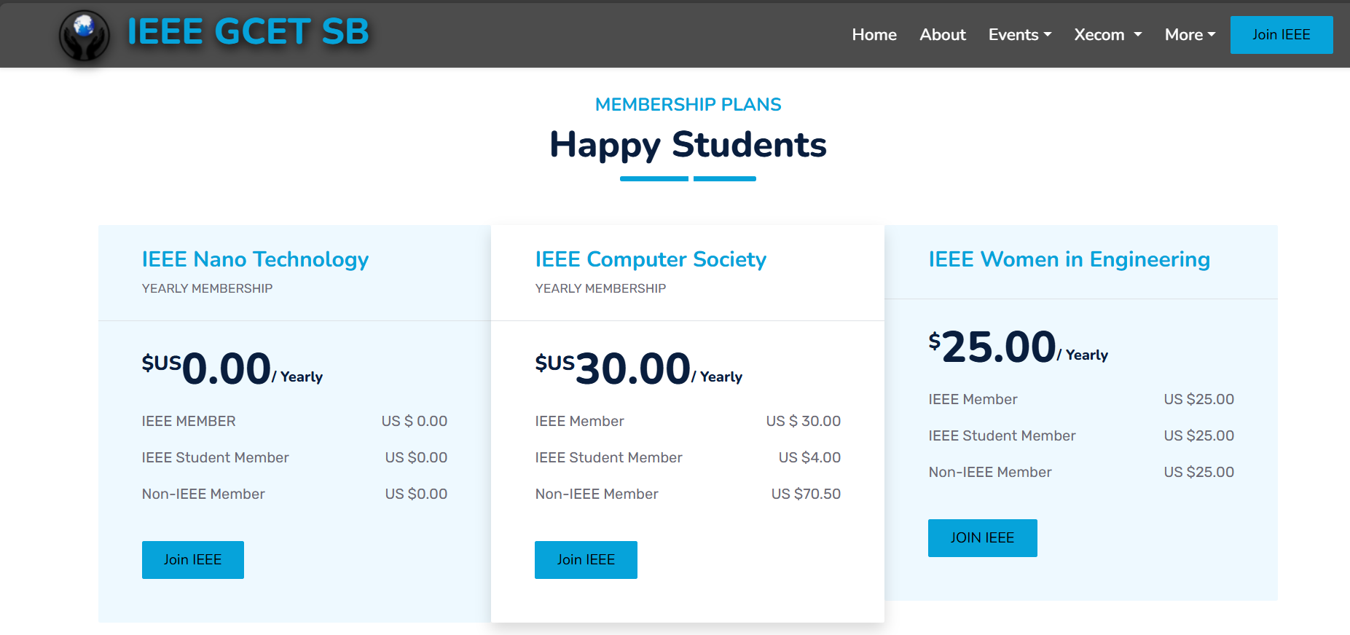
ADVANTAGES
Streamlined Management
Improved Member Engagement
Efficient Event Management
Financial Transparency
Mobile Accessibility
Security and Privacy

Slide 11
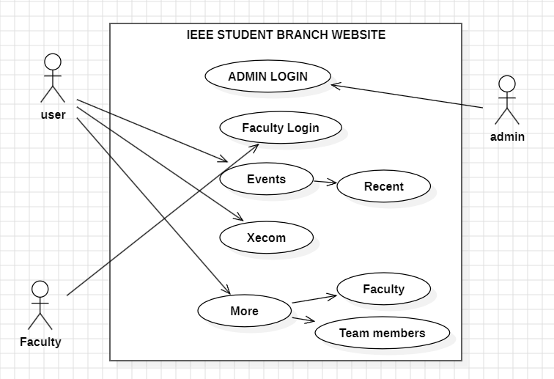
UML DIAGRAMS
Use Case Diagram

Slide 12
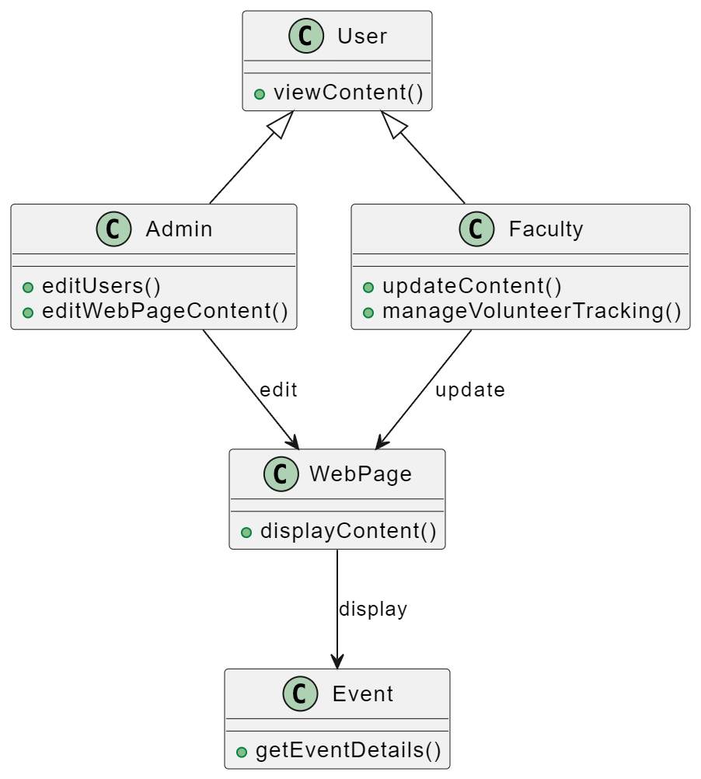
Class diagram

Slide 13
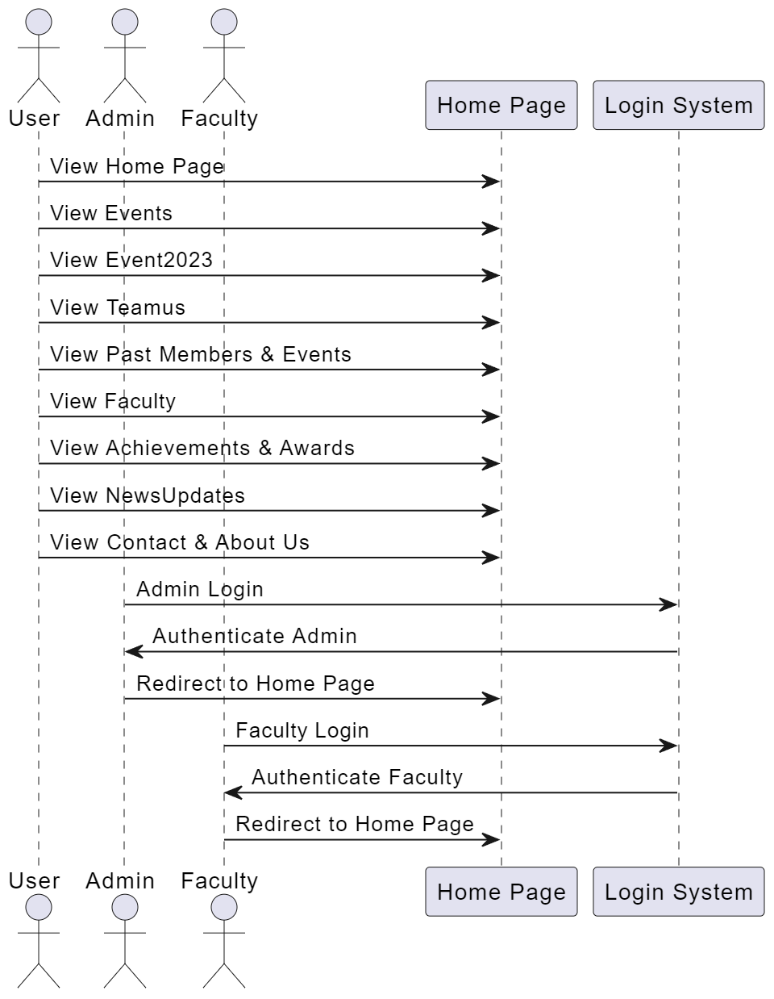
Sequential Diagram

Slide 14
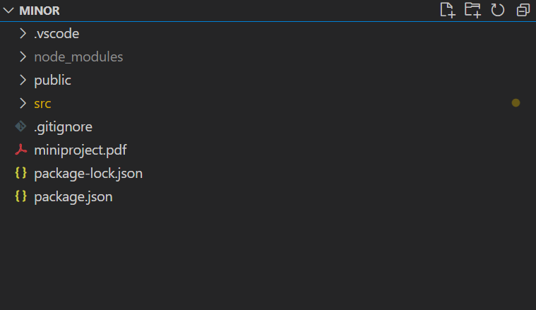
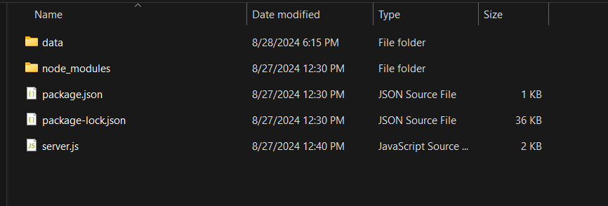
IMPLEMENTATION
Created a React Application for the Front end part and running on port number 3000
Created a server using Mongodb database for the in port number of 5001

Slide 15
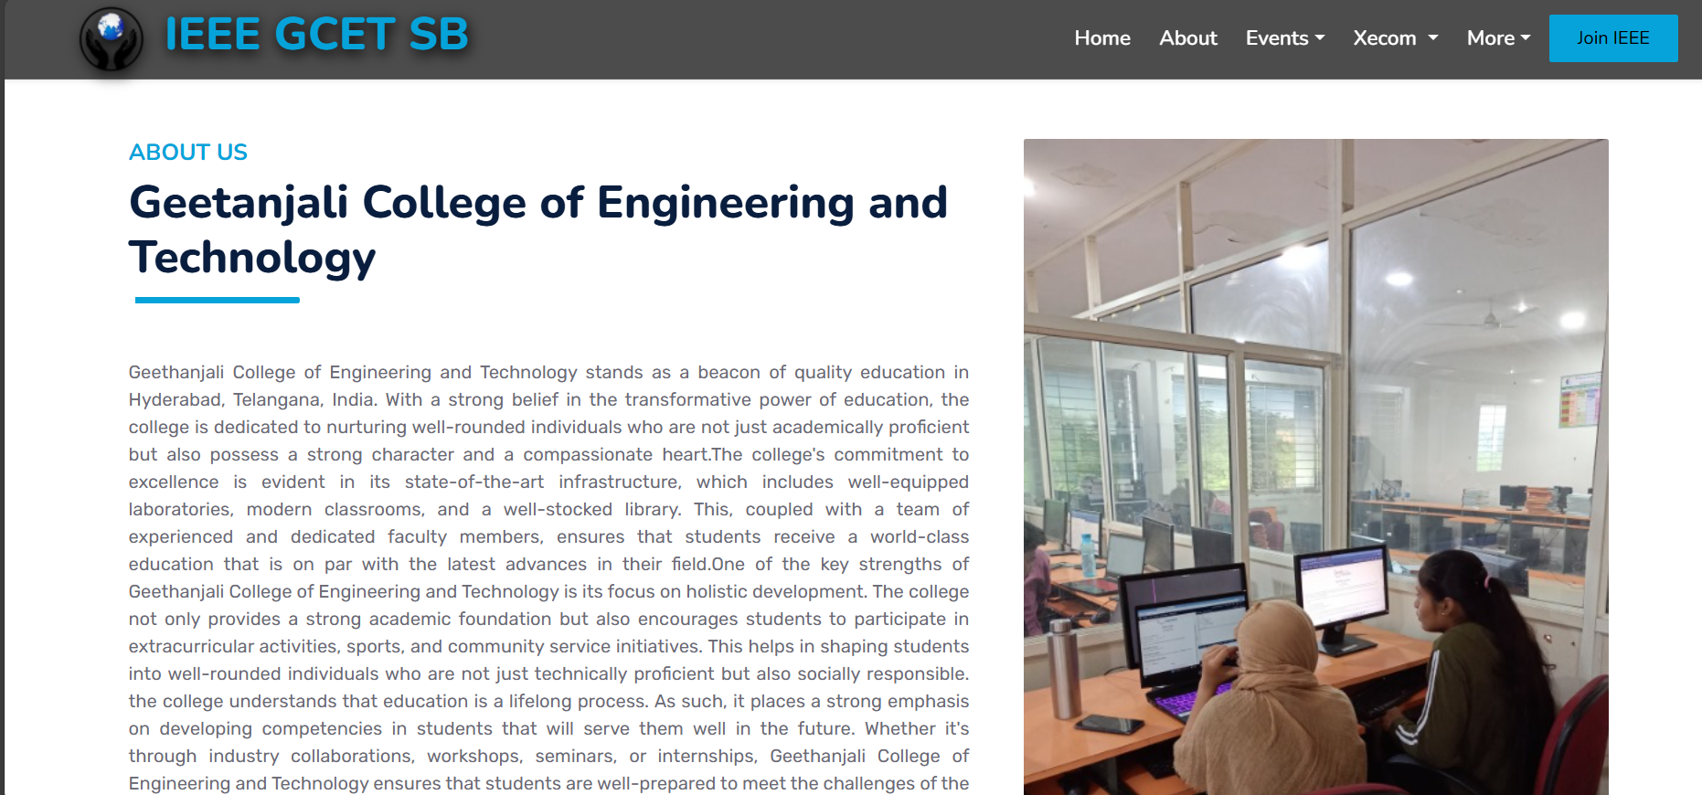
Project Execution
Homepage
About us page
Homepage

Slide 16
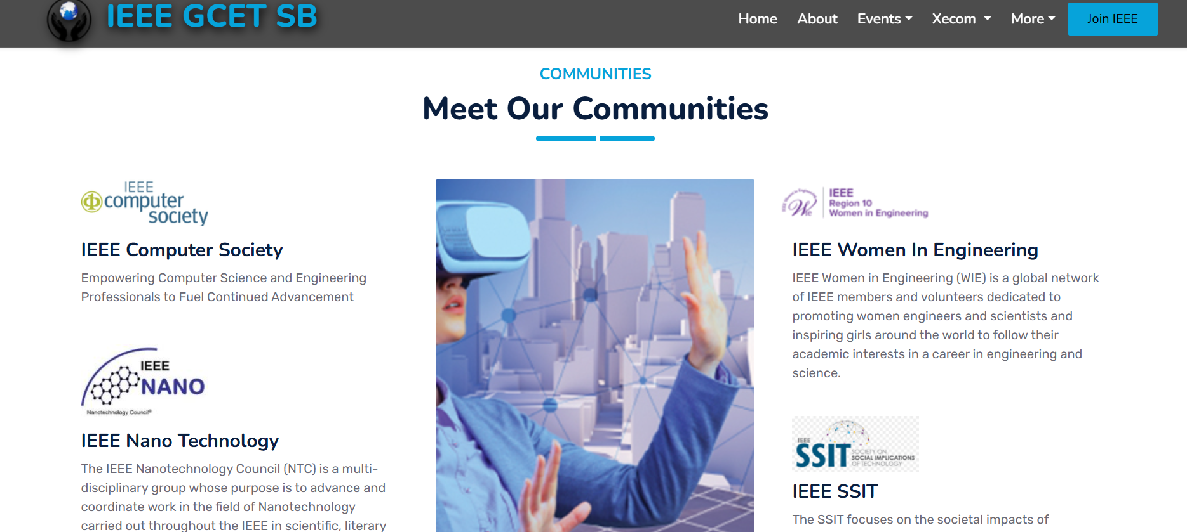
Project Execution
Pricing plan
IEEE Communities

Slide 17
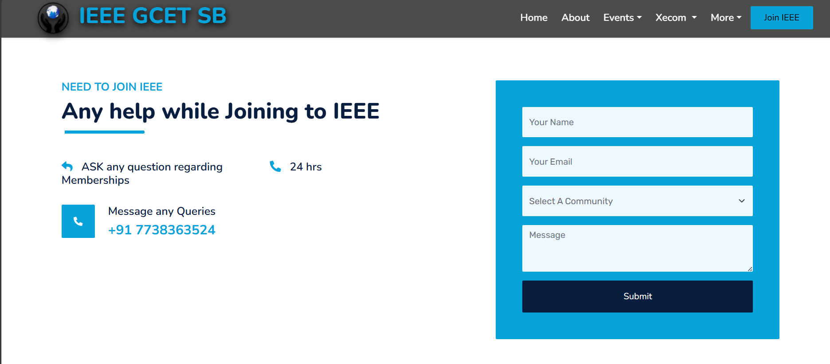
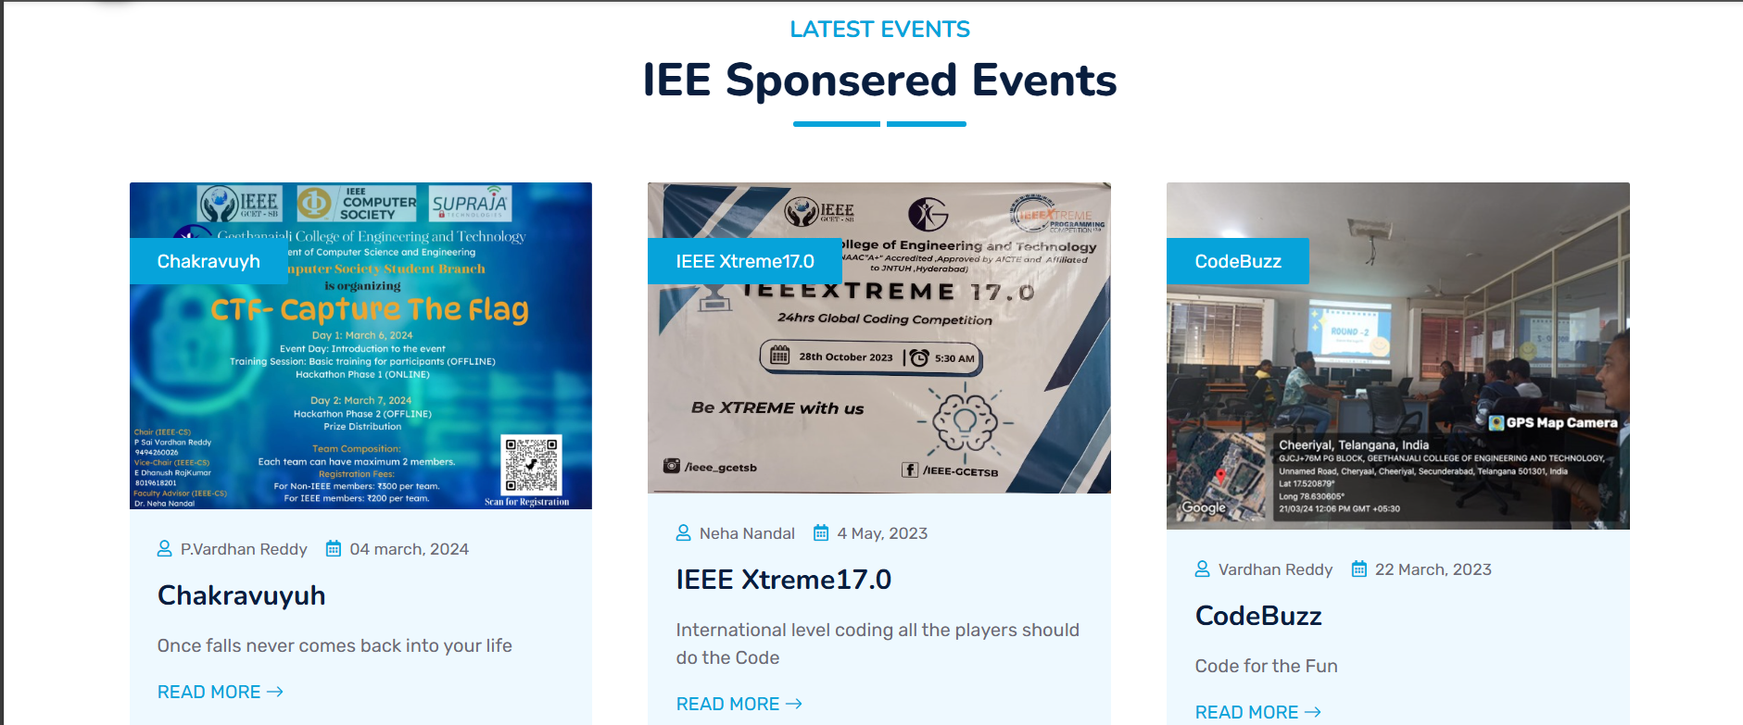
Project Execution
Events
Pricing plans

Slide 18
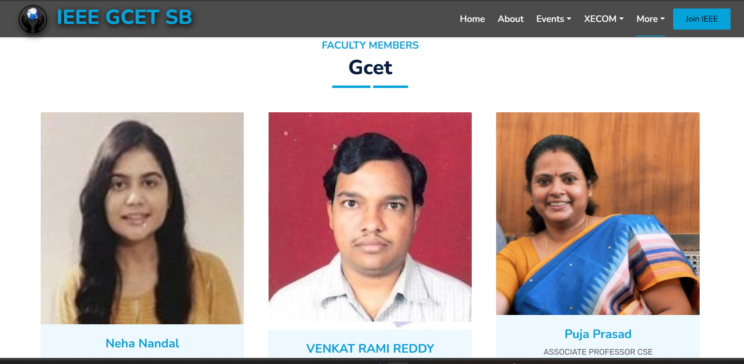
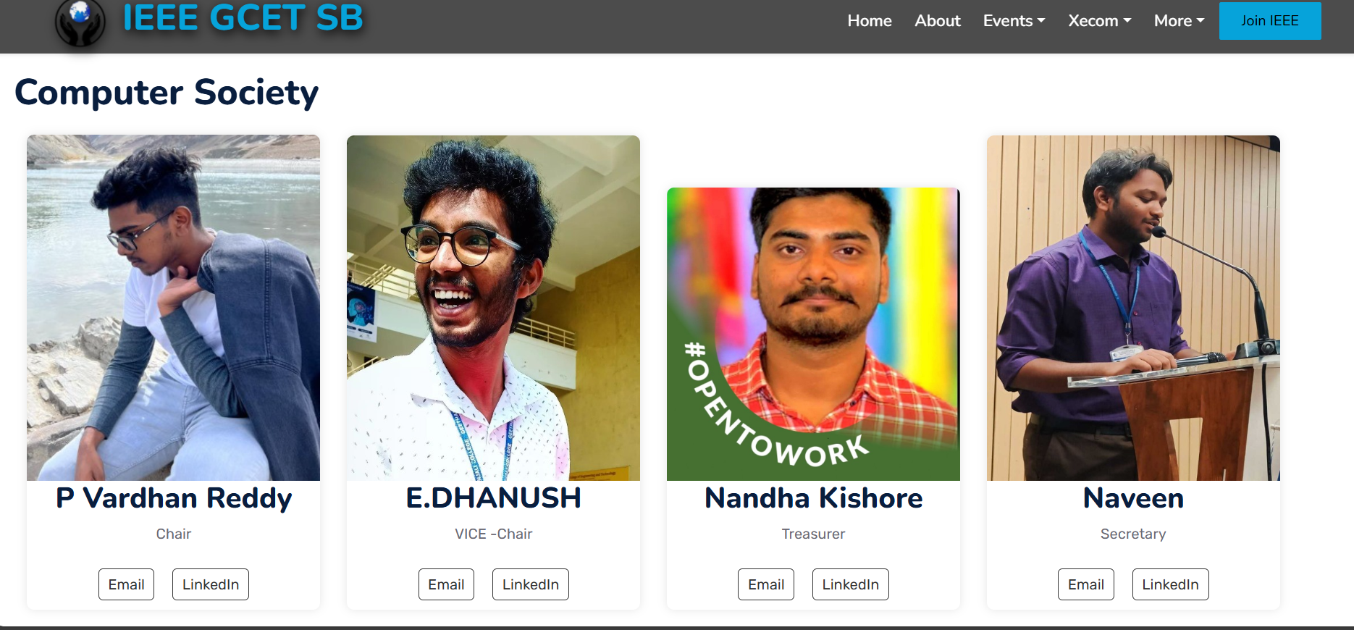
Project Execution
Computer Society members
Faculty Members

Slide 19
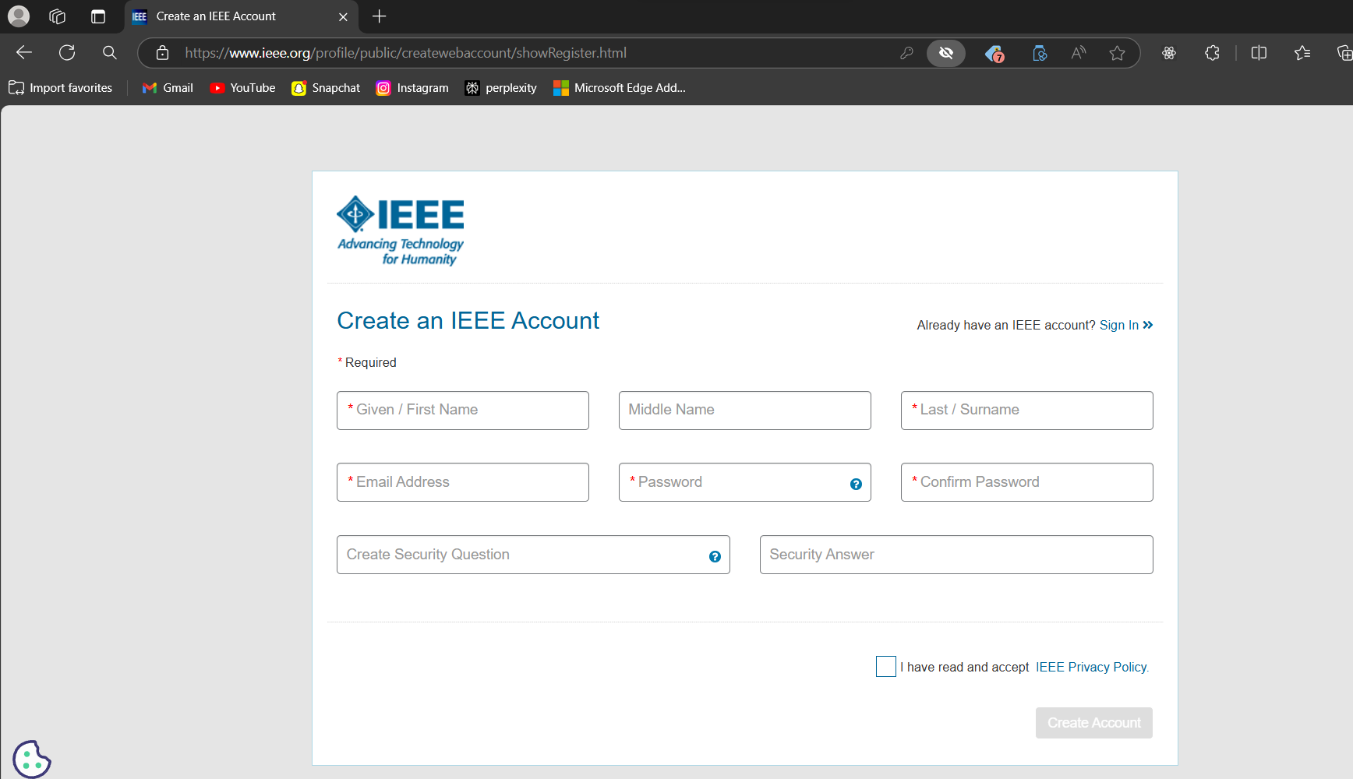
Project Execution
Creation of IEEE account
Announcements /News Updates Section

Slide 20
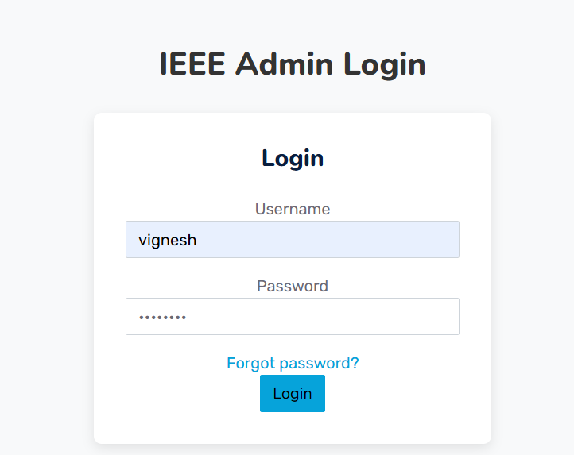
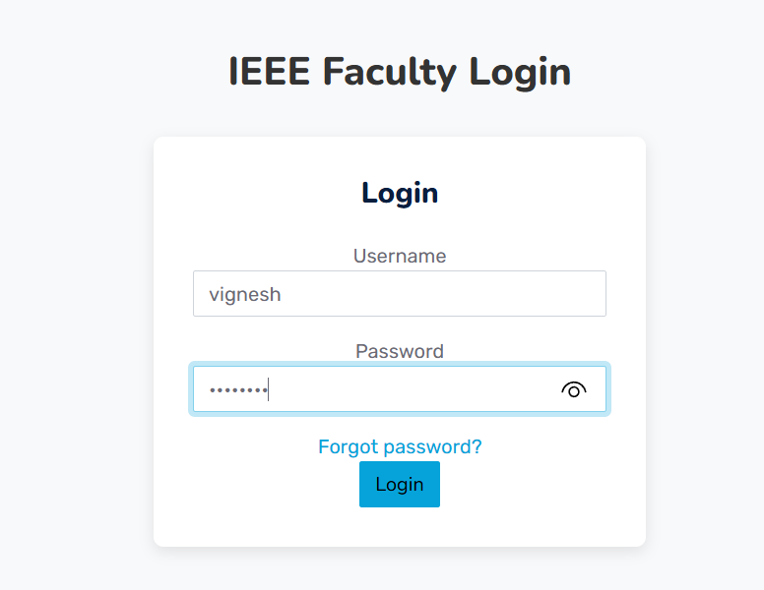
Project Execution
Faculty Login
IEEE Admin Login

Slide 21
Project Execution
After login by Admin or faculty login they would reach the page of home page at present

Slide 22
Future Scope
Enhanced Faculty Involvement: Faculty can update their profiles, track volunteer activities, and monitor event participation through the website. They can access comprehensive data on how members engage in events, providing insights into member contributions and branch performance.
Advanced Admin Capabilities: Admins will have the ability to edit user details, add new members by verifying membership IDs, and leverage data analytics to assess member progress in volunteering and communication skills. This will also enable them to create and optimize events based on member improvement and engagement data.

Slide 23
Conclusion
The IEEE Student Branch website successfully serves as a centralized platform for showcasing the branch's activities, achievements, and resources. By providing modules such as About Us, Events, Xecom, Team Members, Faculty, and News Updates, the website efficiently organizes and presents vital information for current members, prospective students, and faculty. It enhances engagement by offering up-to-date news and event details while also fostering a sense of community through team and faculty profiles. The project has achieved its objective of creating an intuitive, user-friendly interface that supports the branch's mission to promote technological advancement and professional development. This website not only streamlines information access but also acts as a key tool for communication, collaboration, and the growth of the IEEE community within the institution.

Slide 24
Thank You

